Slide 1

Performance Analysis and Strategic Insights for a Dental Clinic Chain in France
A Data-Driven approach to understand and improve center performance
Mohammed El Barhichi
AI Engineering Student
04/12/2024

Slide 2






CONTENT
1
Contextualization
2
Exploratory Data Analysis
3
Data Cleaning
4
Feature Importance and Performance Explainability
5
Clients Segmentation
6
Concurrential Analysis
7
Summary and Recommendations

Slide 3



1. Contextualization
Problem statement :
The client, a private dental clinic chain, seeks to understand what drives its centers’ performance and to what extent it is influenced by operational (internal) factors versus external contextual factors.
Objectifs :
Understand Key Drivers of Performance
Provide Actionable Insights
Evaluate Competitive Landscape
Support Decision-Making with Data
Dataset overview :
71
7
10
Centers in France
Internal factors
External factors

Slide 4
2. Exploratory Data Analysis
Internal Factors:
Latitude and Longitude: Geographic coordinates of the center. Revenue [21; EUR m]: Revenue of the center in 2021 (in millions of Euros). Margin rate [21; %]: Profit margin rate of the center in 2021 (as a percentage). Dentist FTE [#]: Full-time equivalent (FTE) of dentists working at the center. Number of reviews on Google [#]: The number of reviews the center received on Google. Average Google rating: Average rating of the center based on Google reviews. Opening year: The year when the center was opened.
External Factors:
Rent in the area [EUR/sqm]: Rent in the area where the center is located, measured in Euros per square meter. Patients in the catchment area [#]: Total number of potential patients in the area served by the center. Patients' yearly growth in the catchment area [%]: Annual growth rate of the patient population in the catchment area. Share of patients in the catchment area over 65 [%]: Percentage of patients in the catchment area aged over 65. Median revenue in catchment area [EUR]: Median income of individuals in the catchment area. Unemployment rate in the catchment area [%]: Unemployment rate in the catchment area. Poverty rate in the catchment area [%]: Poverty rate in the catchment area. Density of doctors in the catchment area [#/100k patients]: Number of doctors per 100,000 patients in the catchment area. Density of pharmacists in the catchment area [#/100k patients]: Number of pharmacists per 100,000 patients in the catchment area. Density of dentists in the catchment area [#/100k]: Number of dentists per 100,000 patients in the catchment area.

Slide 5
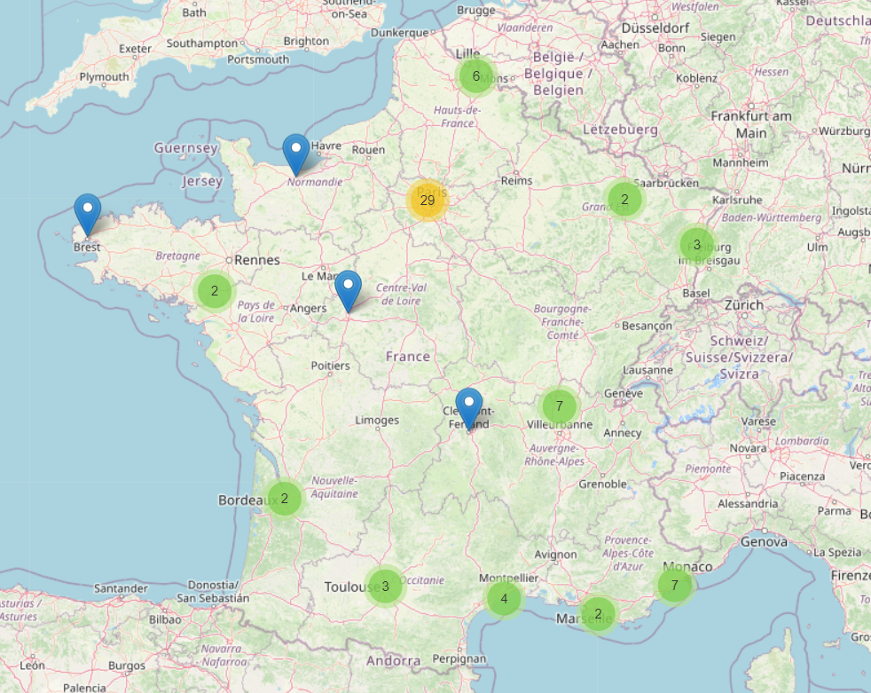
2. Exploratory Data Analysis
Internal Factors:
Latitude and Longitude
Revenue [21; EUR m] Margin rate [21; %] Dentist FTE [#]
Number of reviews on Google [#]
Average Google rating Opening year
External Factors:
Rent in the area [EUR/sqm] Patients in the catchment area [#]
Patients' yearly growth in the catchment area [%]
Share of patients in the catchment area over 65 [%]
Median revenue in catchment area [EUR]
Unemployment rate in the catchment area [%]
Poverty rate in the catchment area [%]
Density of doctors in the catchment area [#/100k patients]
Density of pharmacists in the catchment area [#/100k patients]
Density of dentists in the catchment area [#/100k]

Slide 6
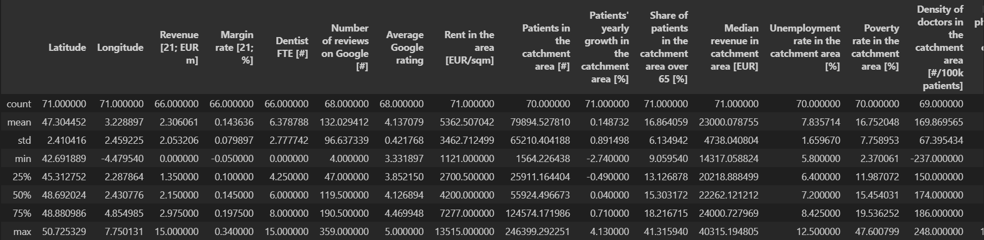
2. Exploratory Data Analysis
df.describe()
Scaling Issue :
Margin Rate

Slide 7
2. Exploratory Data Analysis
df.describe()
Scaling Issue :
Margin Rate
Potential Outliers :
Revenue, Density of doctors,

Slide 8
2. Exploratory Data Analysis
df.describe()
Scaling Issue :
Margin Rate
Potential Outliers :
Revenue, Density of doctors,…
Missing Values :
Revenue, Dentist FTE, Average Google Rating,…

Slide 9
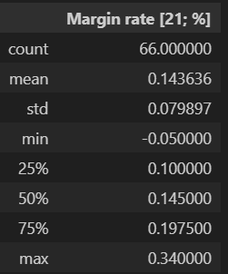
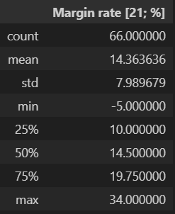
3. Data Cleaning
Handling Scaling Issues :
The values appear to be stored as decimals instead of percentages (0.05 representing 5%)
Multiply by 100

Slide 10
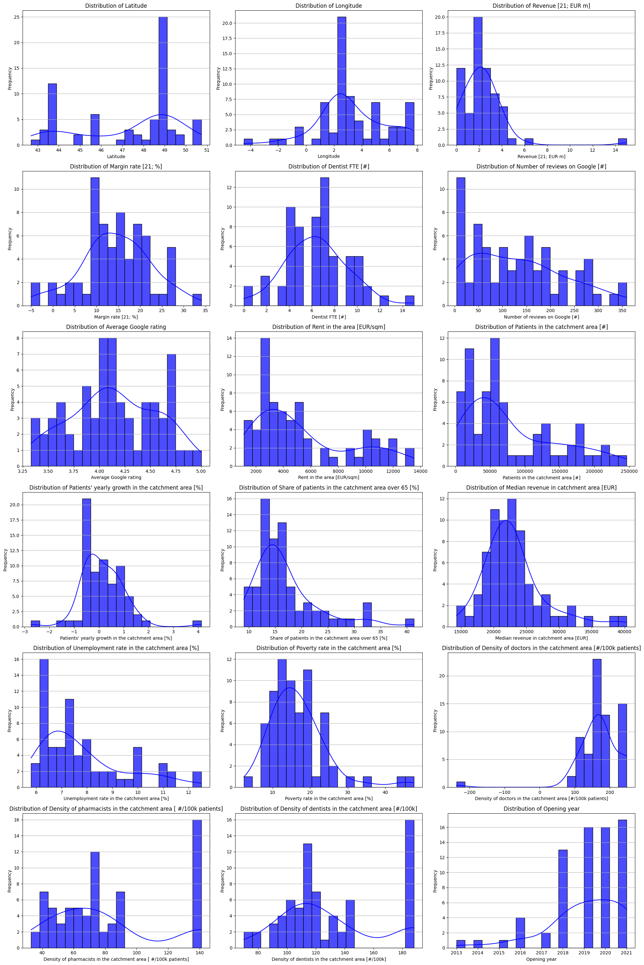
3. Data Cleaning
Handling Outliers:

Slide 11
3. Data Cleaning
Handling Outliers:
Density of doctors in the catchment area
Delete value

Slide 12
3. Data Cleaning
Handling Outliers:
Margin rate
The costs of these centers exceeded their revenues during the year of 2021
Dentist FTE
Non-operational or temporarily inactive centers

Slide 13
3. Data Cleaning
Handling Outliers:
Revenue
Two potential outliers :
Revenue = 0
Revenue = 15

Slide 14
3. Data Cleaning
Handling Outliers:
Revenue
Two potential outliers :
Revenue = 0
Revenue = 15
Revenue = 0
Rows with negative Margin Rate, null Dentist FTE, no data Google Rating
Non-operational or temporarily inactive centers

Slide 15
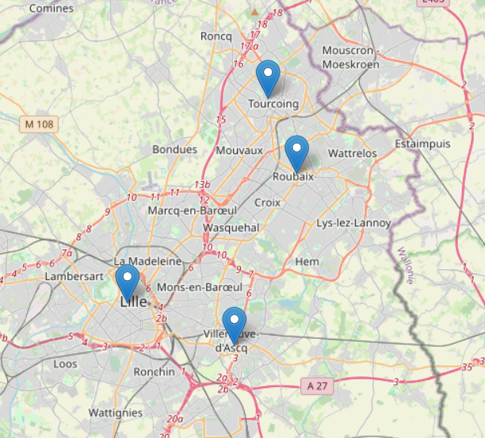
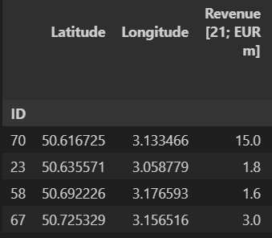
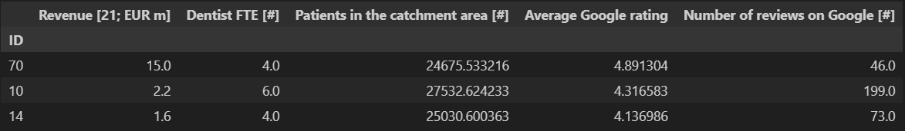
3. Data Cleaning
Handling Outliers:
Revenue
Revenue = 15
Geographical Analysis
Nearby centers within 15 km
Operational Analysis
Two potential outliers :
Revenue = 0
Revenue = 15
Revenue = 0
Similar operational characteristics
Rows with negative Margin Rate, null Dentist FTE, no data Google Rating
Delete value
Non-operational or temporarily inactive centers

Slide 16
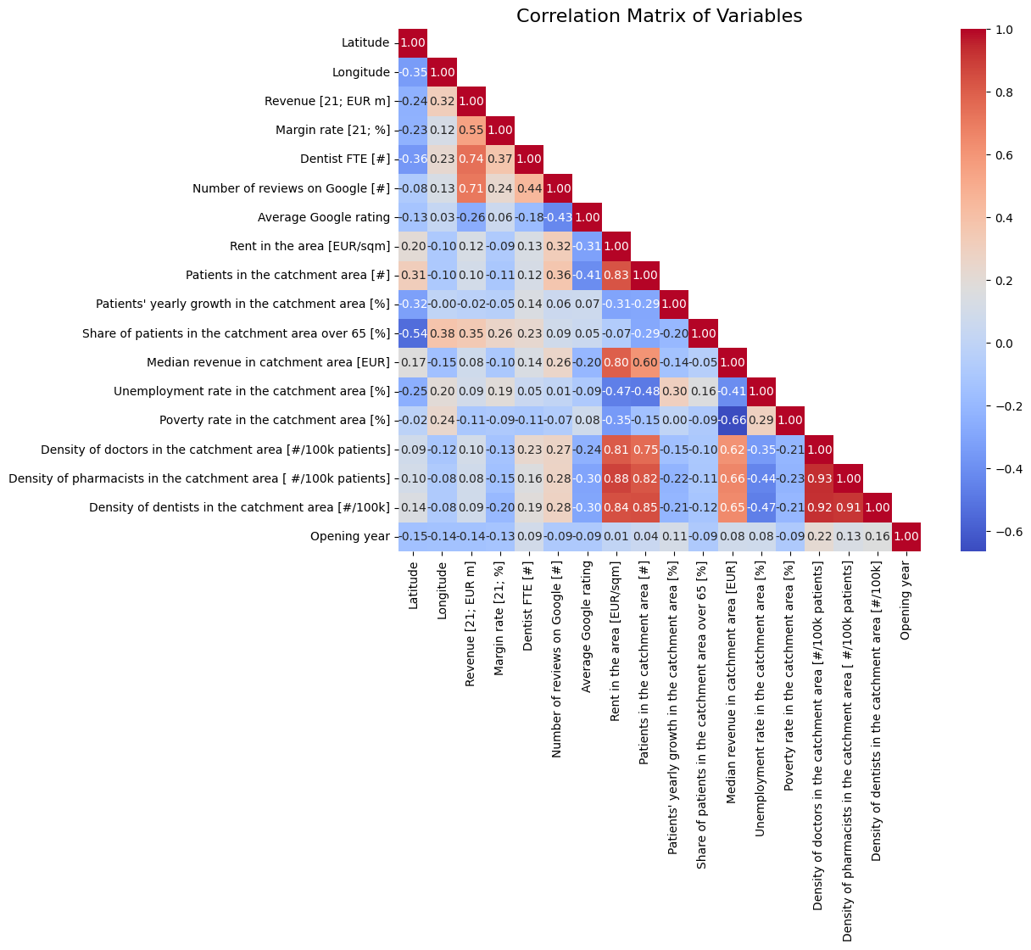
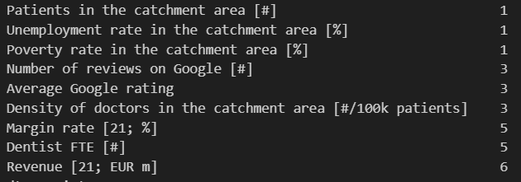
3. Data Cleaning
Handling Missing Values:
Correlation Matrix :
Missing values :

Slide 17
3. Data Cleaning
Handling Missing Values:
Patients in the Catchment Area :
Strong correlation with :
Rent in the area [EUR/sqm]
Density of pharmacists in the catchment area [ #/100k patients]
Density of dentists in the catchment area [#/100k]
Imputation using a Linear Regression model

Slide 18
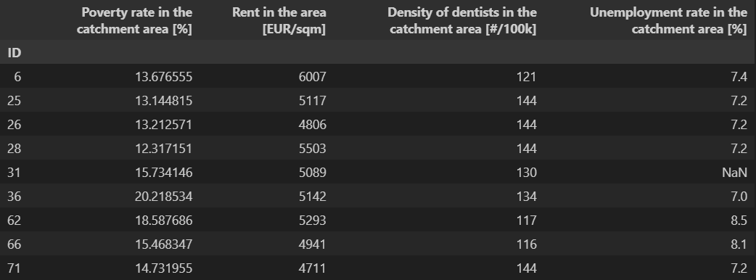
3. Data Cleaning
Handling Missing Values:
Patients in the Catchment Area :
Unemployment rate :
Strong correlation with :
Rent in the area [EUR/sqm]
Density of pharmacists in the catchment area [ #/100k patients]
Density of dentists in the catchment area [#/100k]
Imputation using a Linear Regression model
Imputation using the mean of similar row in the most related features

Slide 19
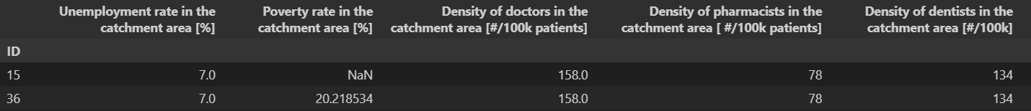
3. Data Cleaning
Handling Missing Values:
3. Poverty Rate
The two centers are in the same catchment area
Imputation using the value of the other center

Slide 20
3. Data Cleaning
Handling Missing Values:
3. Poverty Rate :
The two centers are in the same catchment area
Imputation using the value of the other center
4. Number of reviews on Google and Average Google rating :
Strong correlation with :
Patients in the catchment area [#]
Density of dentists in the catchment area [#/100k]
Imputation using KNN_Imputer

Slide 21
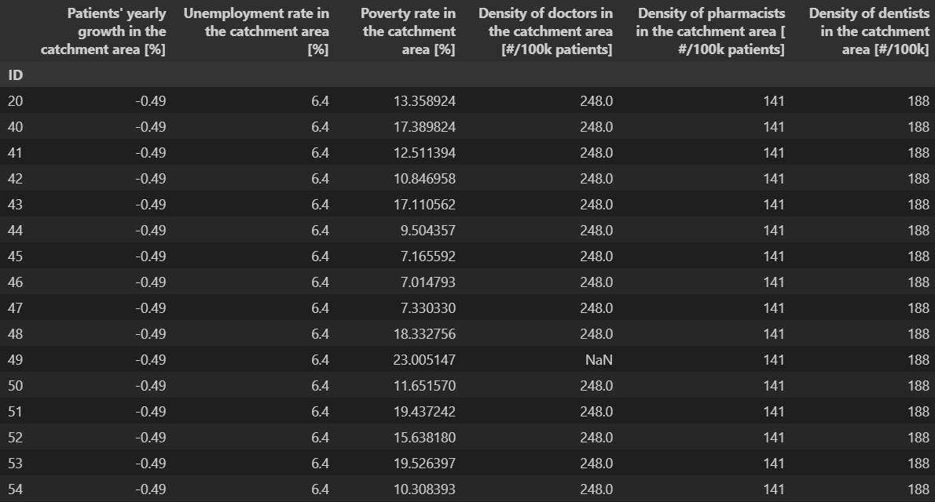
3. Data Cleaning
Handling Missing Values:
3. Poverty Rate :
The two centers are in the same catchment area
Imputation using the value of the other center
4. Number of reviews on Google and Average Google rating :
Strong correlation with :
Patients in the catchment area [#]
Density of dentists in the catchment area [#/100k]
Imputation using KNN_Imputer
5. Density of Doctors in the Catchment Area :
16 centers are in the same Catchment Area
Imputation using the value of the other centers

Slide 22
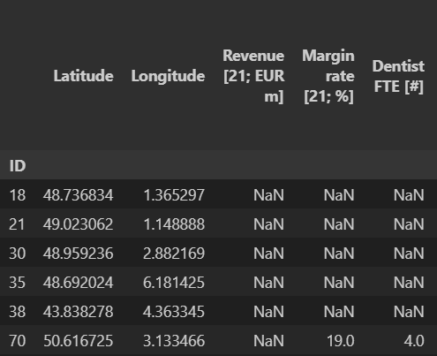
3. Data Cleaning
Handling Missing Values:
6. Revenue, Marge Rate and Dentists FTE :

Slide 23
3. Data Cleaning
Handling Missing Values:
6. Revenue, Marge Rate and Dentists FTE :
The outlier with 15 as Revenue
KNN Imputer : Value of 1,6
The original value of 15.0 was likely a misentry, where 1.5 was intended
Imputation using the value 1,5

Slide 24
3. Data Cleaning
Handling Missing Values:
6. Revenue, Marge Rate and Dentists FTE :
Highly correlated columns
Traditional imputation methods are not effective : dependency between variables
Imputation using advanced Iterative Imputer
The outlier with 15 as Revenue
KNN Imputer : Value of 1,6
The original value of 15.0 was likely a misentry, where 1.5 was intended
Imputation using the value 1,5

Slide 25
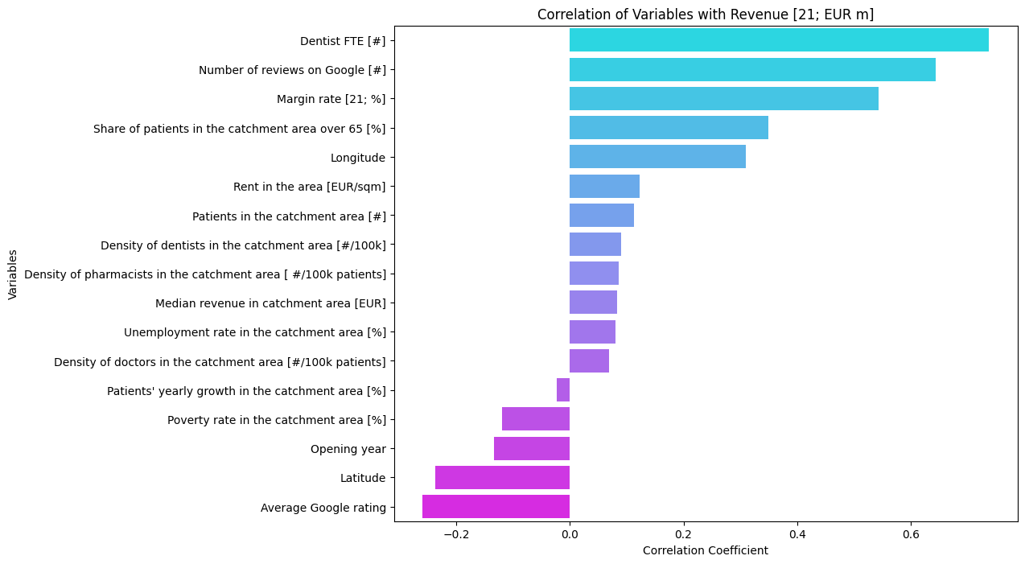
4. Feature Importance and Performance Explainability
Target : Revenue
Correlation Analysis :
Strong direct correlation between many internal factors and the target
Negative correlation with Average Google rating : Non-Linear relationships

Slide 26
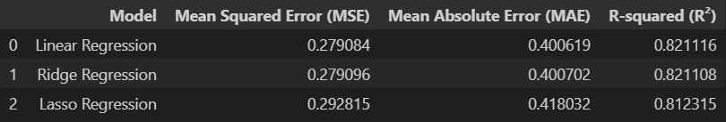
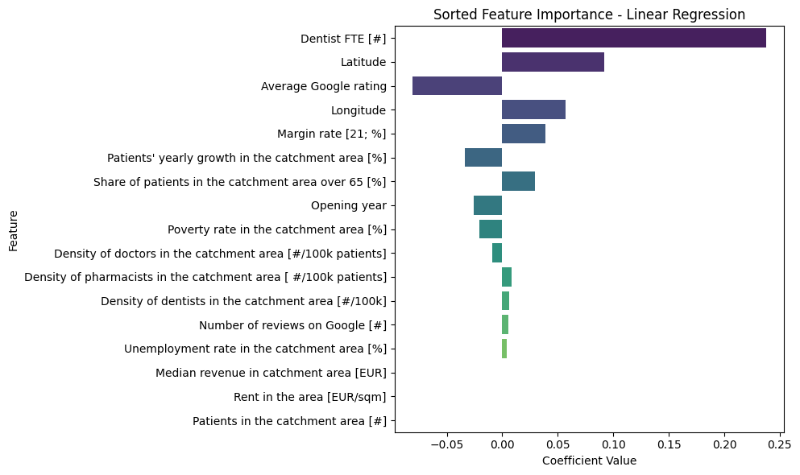
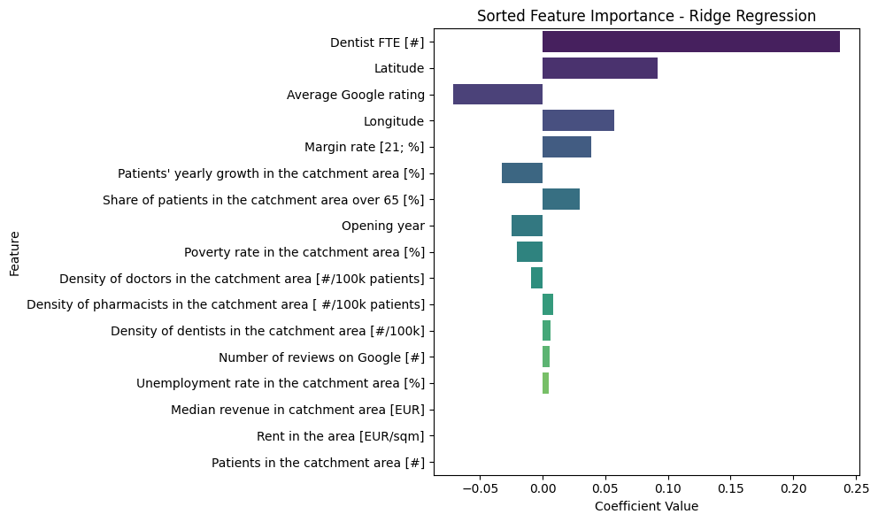
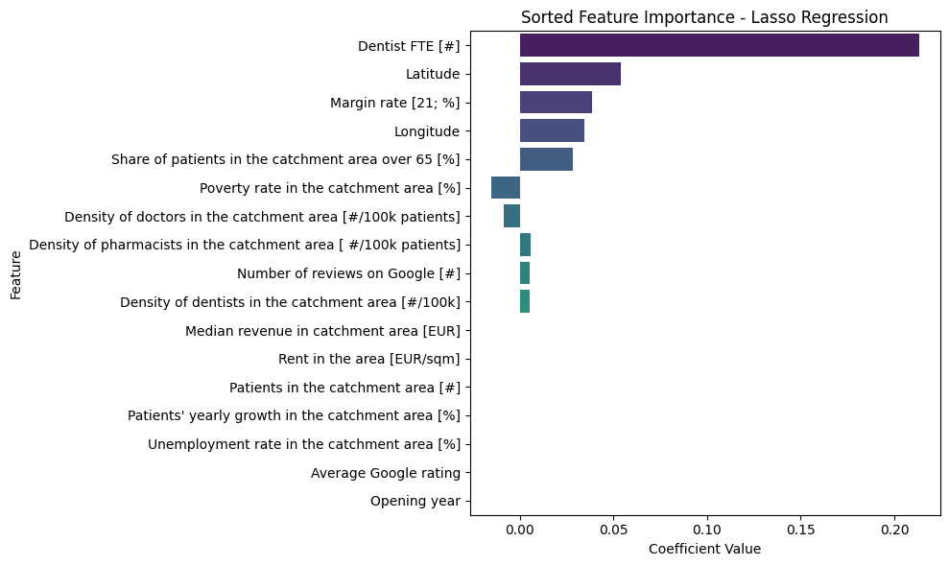
4. Feature Importance and Performance Explainability
Simple Models :
Internal factors have significant positive impacts on revenue across all models
Average Google rating show negative contributions, its relationships with revenue might be more complex or involve interactions with other factors.

Slide 27
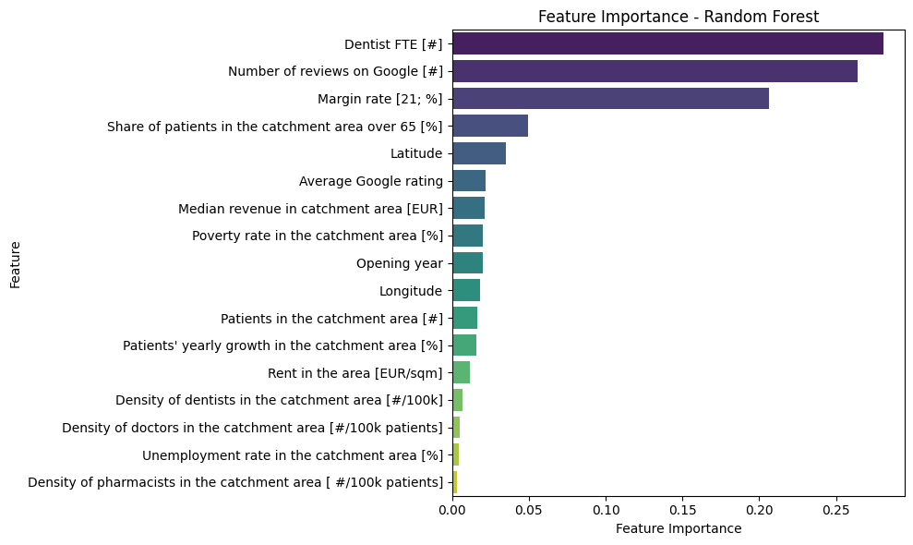
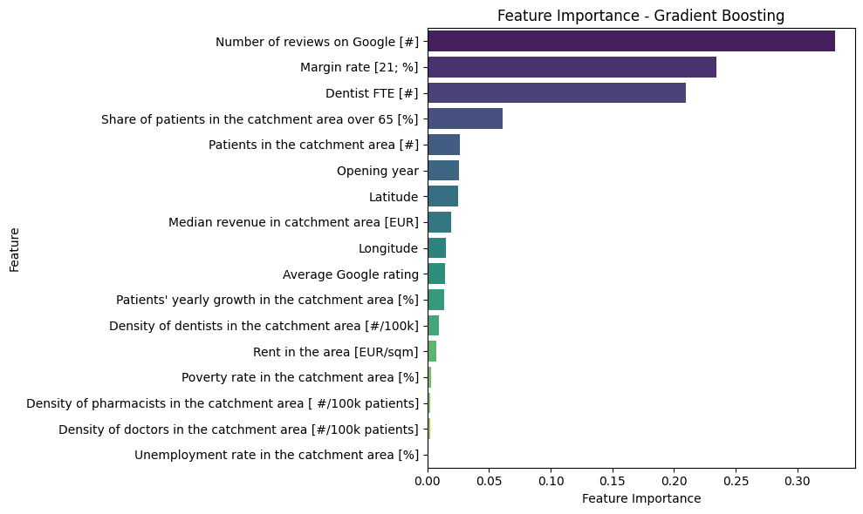
4. Feature Importance and Performance Explainability
Non-Linear Models :
Random Forest
Gradient Boosting :
`Number of reviews on Google [#]` emerges as the most influential feature, accounting for 33% of the importance.
`Margin rate [21; %]` and `Dentist FTE [#]` remain critical, aligning with the findings from linear models.
`Average Google rating`, while still less impactful than other internal factors, shows a slight increase in importance compared to linear models.
Internal factors consistently emerge as the most critical drivers of revenue across all model like `Dentist FTE [#]`, `Number of reviews on Google [#]`, and `Margin rate [21; %]` that are the top contributors
External factors play a secondary role in influencing revenue with demographic variables like `Share of patients in the catchment area over 65 [%]` and `Patients in the catchment area [#]` that are moderately important.

Slide 28
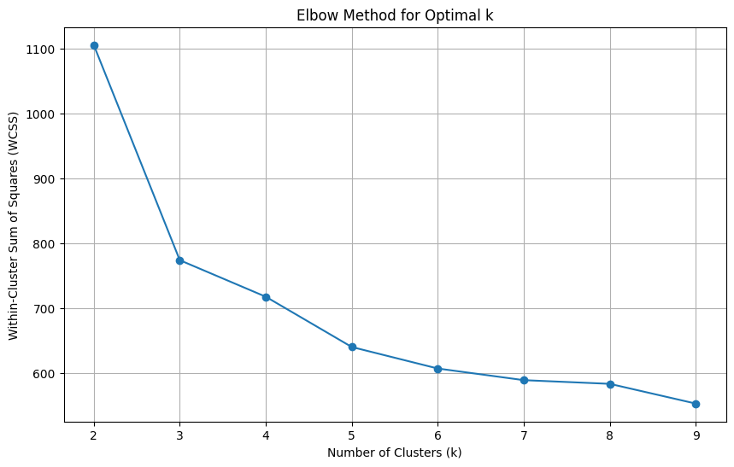
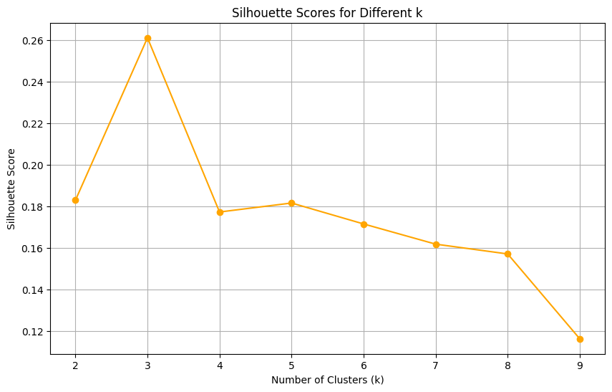
5. Clients Segmentation
Unsupervised method : K-Means
Elbow Method :
Silouette Score :
K = 3

Slide 29
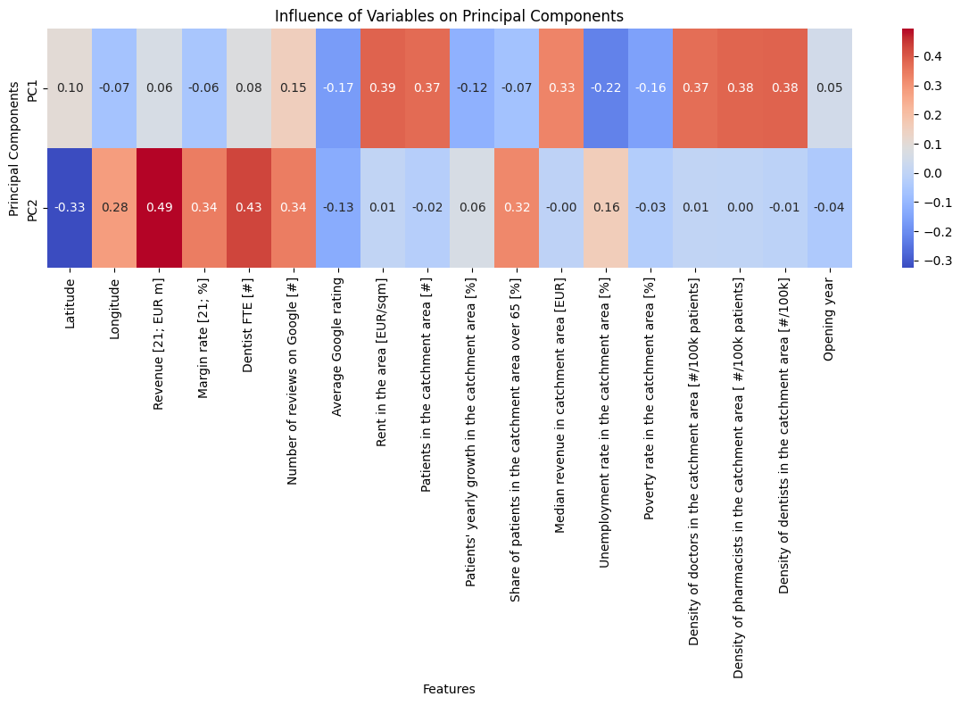
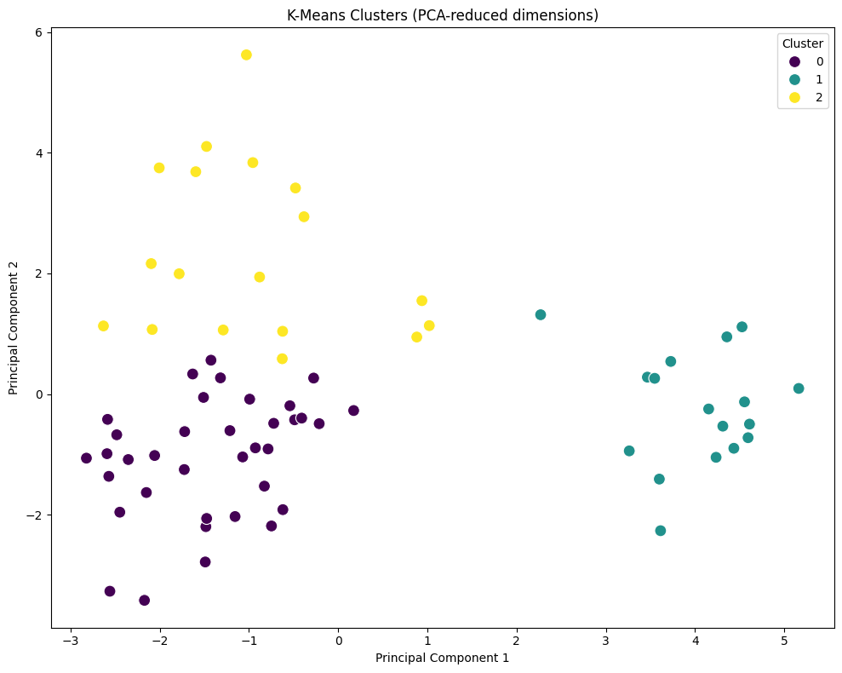
5. Clients Segmentation
Unsupervised method : K-Means
PCA Analysis :
Clusters Visualization:

Slide 30
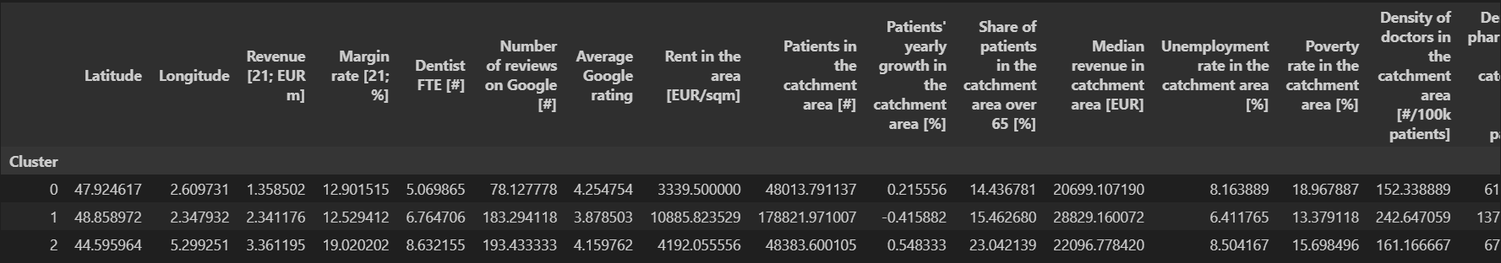
5. Clients Segmentation
Unsupervised method : K-Means
Cluster Summary :
Cluster 0: Moderate Performers:
Centers with moderate revenue and profitability.
Moderate staffing levels and reviews.
Located in regions with lower patient density and higher elderly population.
Recommendation: Focus on operational optimizations and building stronger customer engagement to boost Google ratings and profitability.
Cluster 1: High-Demand Urban Centers:
High revenue centers operating in high-cost, high-density urban areas.
Relatively lower Google ratings despite having many reviews.
Recommendation: Improve customer satisfaction (like patient experience, Google ratings) and optimize costs in these high-rent areas.
Cluster 2: Top Performers:
Centers with the highest revenue and profitability, well-staffed with good Google ratings.
Operate in areas with affluent demographics but moderate patient density.
Recommendation: Maintain operational excellence while exploring premium services or expanding in similar regions.

Slide 31
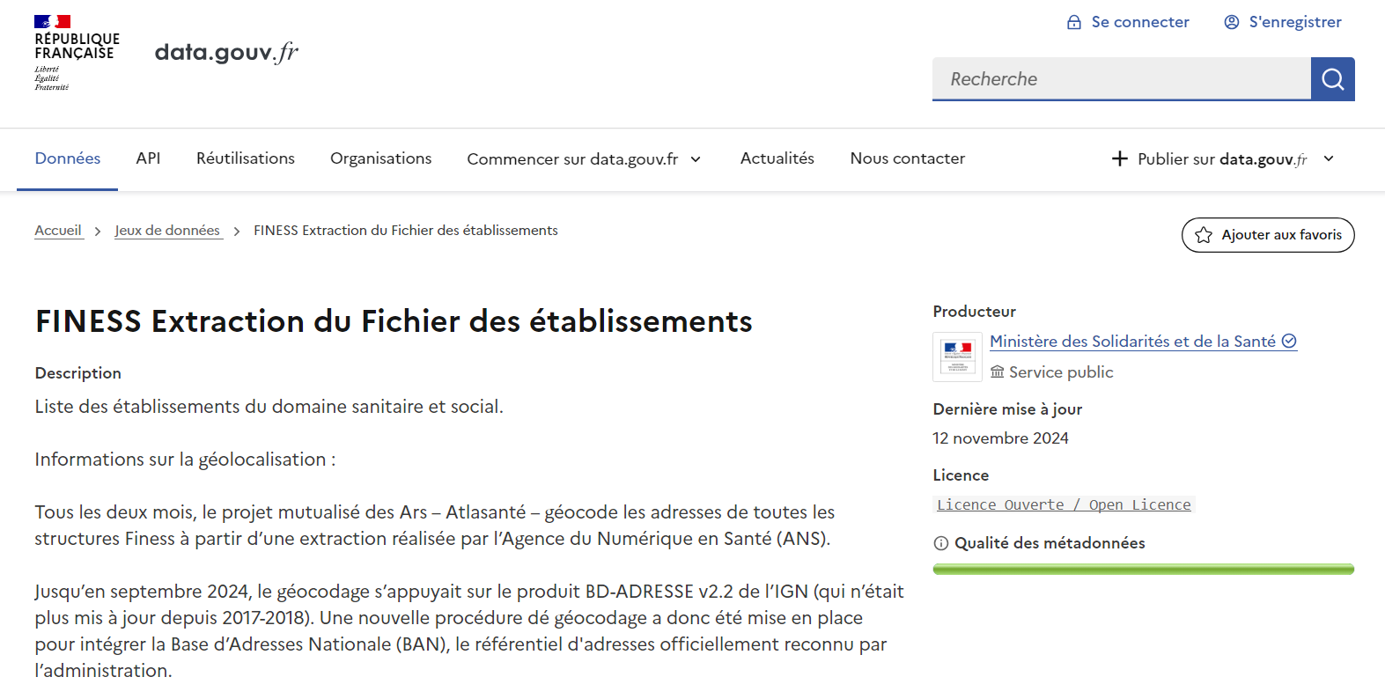
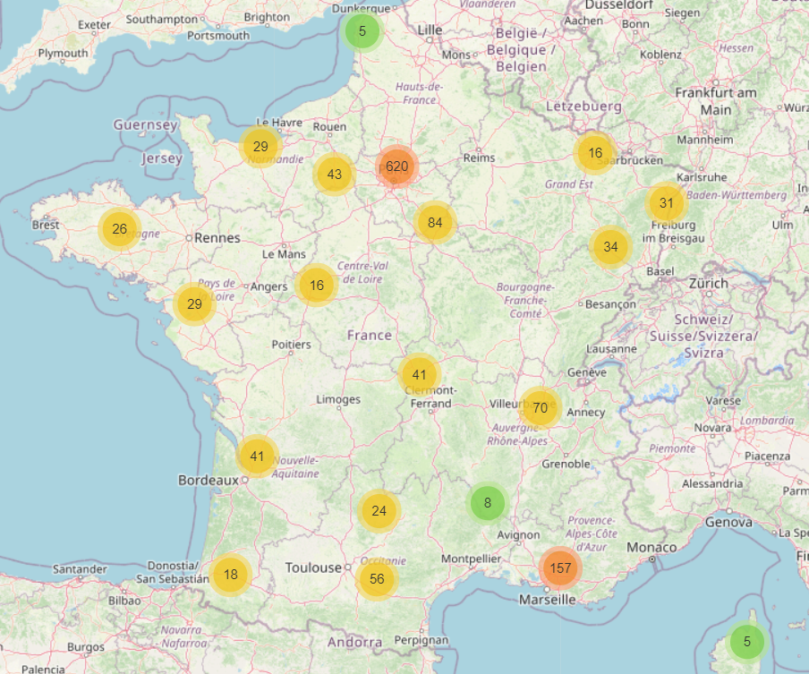
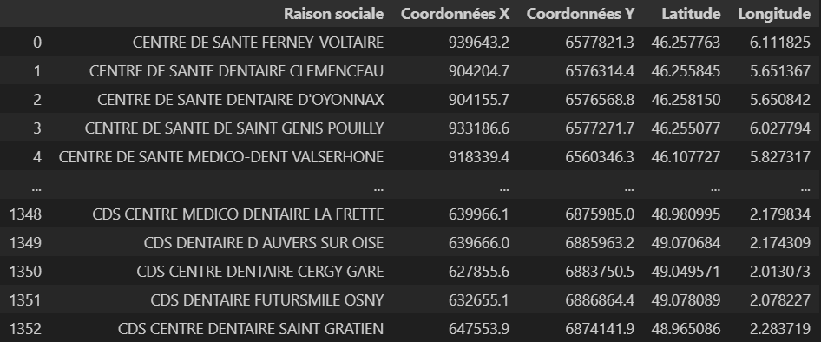
6. Concurrential Analysis
6.1. Identifying Competitors
Data source :
Relevant columns :

Slide 32
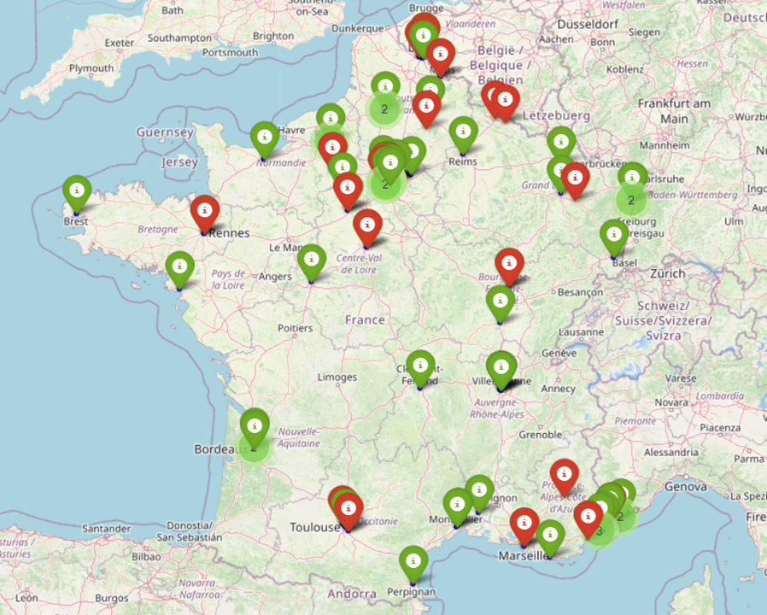
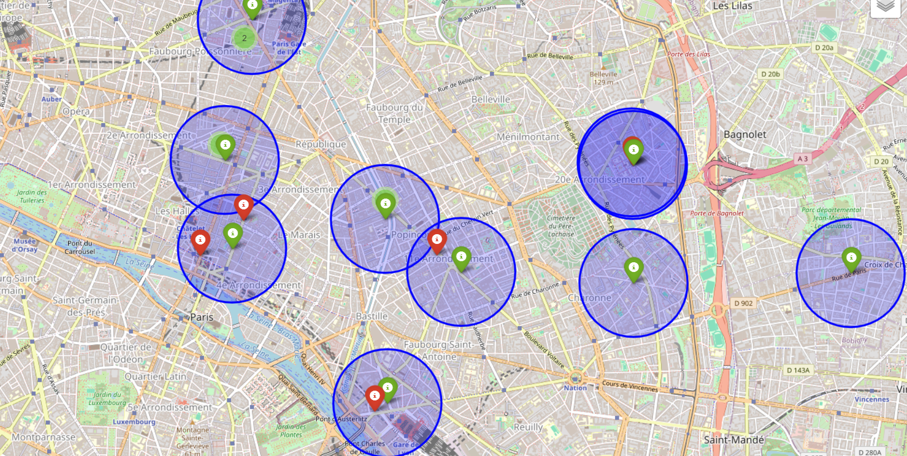
6. Concurrential Analysis
6.2. Identifying Direct Competitors
Adding a new column :
Competitive Intensity : Number of competitors in the same catchment area ( 30m to 500m)
Visualization :

Slide 33
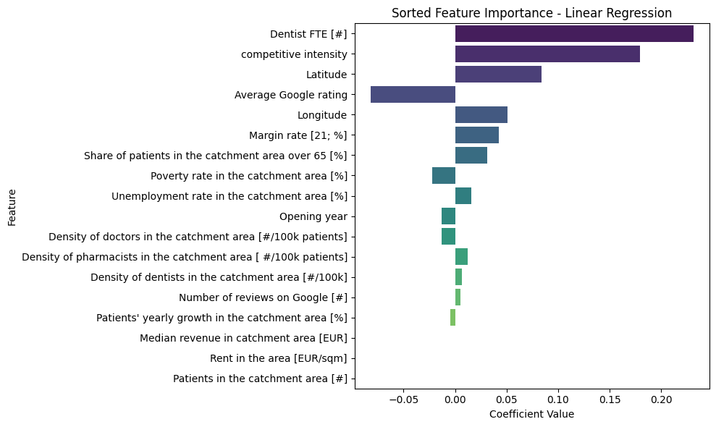
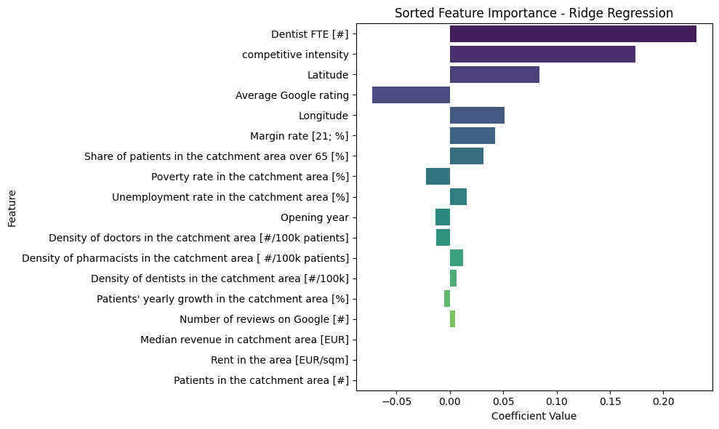
6. Concurrential Analysis
6.3. Reassessment with Competitive Intensity
Feature Importance :
Observation:
Interestingly, we found a positive correlation between competitive intensity and revenue. Initially, it was expected that more competitors would result in lower revenues, as competition typically divides market share. However, the results reveal a different pattern.
Marketing Insight:
This finding aligns with a known marketing principle: the presence of competitors in close proximity can create a market concentration effect. When multiple centers exist in the same area, they collectively attract more clients, as potential customers are more likely to choose the area when they have multiple options. The decision is no longer whether to visit the area but rather which center to choose once there.
Balanced Competition:
However, the positive correlation is not infinite. The analysis suggests there is an optimal level of competition:
Having too few competitors may fail to create the market concentration effect, resulting in lower revenues.
Having too many competitors may oversaturate the market, causing revenue to diminish.

Slide 34
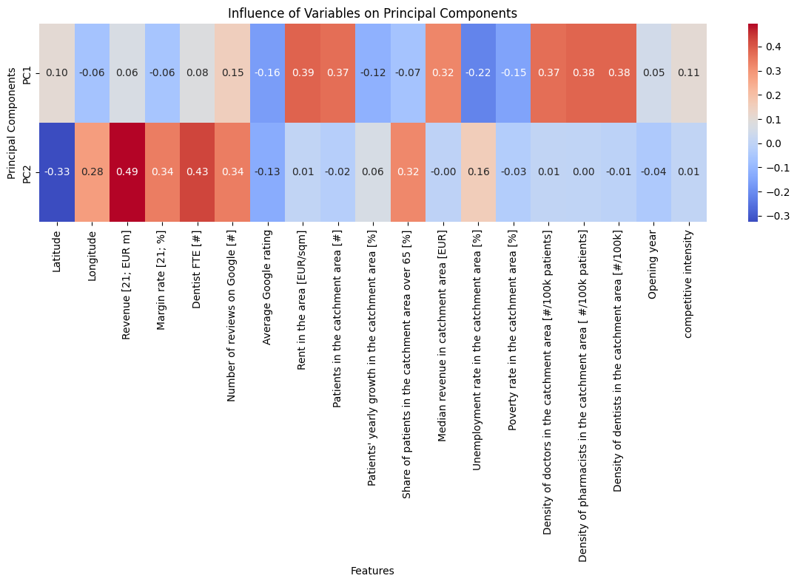
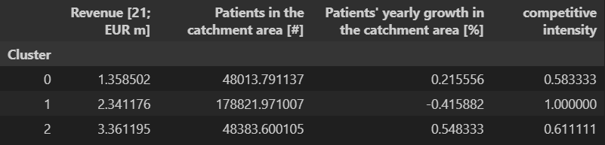
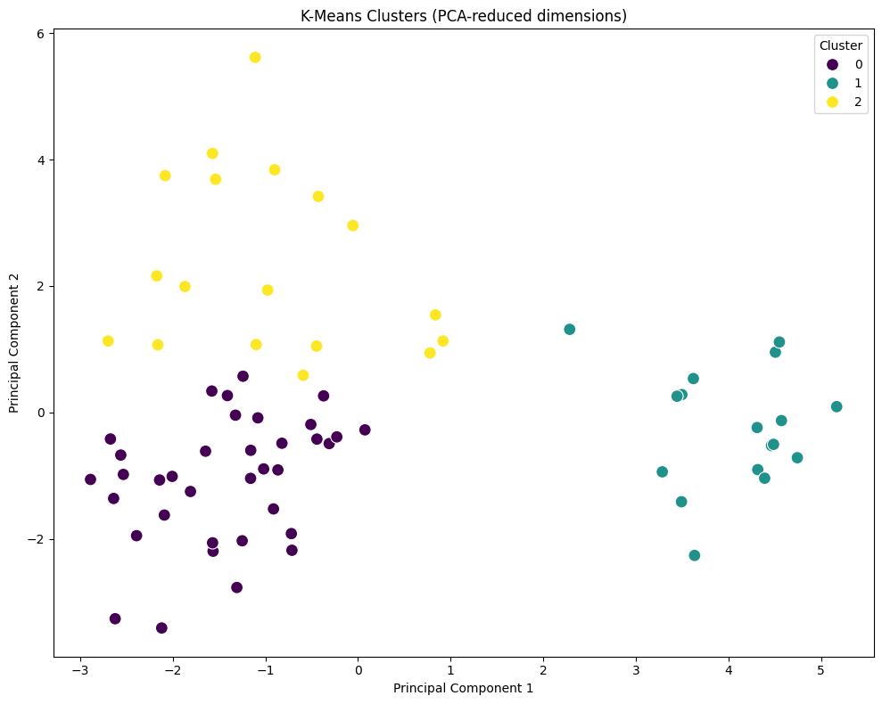
6. Concurrential Analysis
6.3. Reassessment with Competitive Intensity
Client Segmentation:
PC Analysis :
Cluster Summary :
- Low Competition (Cluster 0): Fails to attract enough clients due to a lack of market concentration.
- High Competition (Cluster 1): Leads to diminishing returns as the market becomes oversaturated.
- Moderate Competition (Cluster 2): Strikes the right balance, creating enough market pull while keeping oversaturation in check.
Strategic Placement:
When opening new centers, aim for areas with moderate competitive intensity. These areas are likely to yield the best revenues, as they attract sufficient demand without being oversaturated.
Performance Optimization:
Centers in areas with low competition may benefit from marketing strategies to increase local visibility and draw clients from neighboring areas.
Centers in areas with high competition could focus on differentiation strategies (e.g., better customer service, specialized treatments) to capture a larger share of the local market.
Clusters Visualization :

Slide 35
7. Summary and Recommendations
Internal Factors as the Primary Drivers:
Dentist FTE (#), Number of Google reviews, and Margin rate (%) are the strongest predictors of revenue, emphasizing the importance of operational efficiency and customer engagement and centers with higher staffing levels and stronger online presence tend to perform better.
Role of External Factors:
External factors like Patients in the catchment area and Share of patients show moderate importance, indicating that while demographics matter, they are less influential than internal factors.
Competitive Intensity:
Interestingly, competitive intensity shows a positive correlation with revenue, but only up to a point. Moderate levels of competition enhance performance by creating market concentration, while oversaturation diminishes returns.
Cluster 0: Moderate Performers:
Centers with low revenue and low competitive intensity. Typically located in regions with lower patient density and higher elderly populations.
Recommendation: Focus on operational improvements and marketing strategies to boost customer engagement and visibility.
Cluster 1: High-Demand Urban Centers:
Centers with moderate revenue, operating in high-cost, high-density urban areas. These centers face intense competition but tend to underperform in customer satisfaction metrics (e.g., Google ratings).
Recommendation: Improve patient experience and differentiate services to gain a competitive edge in saturated markets.
Cluster 2: Top Performers:
Centers with the highest revenue and profitability, operating in areas with moderate competitive intensity and affluent demographics.
Recommendation: Maintain operational excellence while exploring premium service offerings or expanding into similar markets.
Strategic Expansion: When opening new centers, prioritize areas with moderate competitive intensity and favorable demographics to maximize revenue potential and avoid markets with either low competition (insufficient demand) or high competition (oversaturated).
Operational Excellence: Invest in staffing levels and ensure high-quality service delivery to boost operational efficiency and strengthen online presence by encouraging customer reviews and maintaining high Google ratings.
Localized Strategies: For low-performing centers in areas with low competition, focus on increasing visibility through targeted marketing campaigns. In highly competitive areas, differentiate services through innovation and enhanced patient experiences.
Monitor Competitive Intensity: Regularly assess competitive intensity and its impact on center performance to identify emerging opportunities or threats.

Slide 36

THANK YOU

